Slide 1
Project presentation #3 Iris

Slide 2
TABLE OF CONTENTS
TABLE OF CONTENTS
PRODUCT OVERVIEW
Delete Lines, calculate new correlation
Create new model(hand,numpy,sklearn)l
Predicted TV, calculate ^yi
RSE
MSE
Standard Error
Normal Distribution
Confidence Interval
1
2
3
4
5
6
7
8

Slide 3
Why we need to Delete lines?
According to the scatter plot, we can see that there is 2 outliers in Newspaper, which are larger than 93.6(upper bound).
Line 16 and Line 101 are the outliers, need to delete these two lines in each row.
*Why we need to delete whole row( include other feature)?
-other features don’t have reference value to compare to useless value in Newspaper
-Now: only have 198 lines
Calculate the correlation between TV and Sales again
-0.779, not 0.78
–more accurate

Slide 4
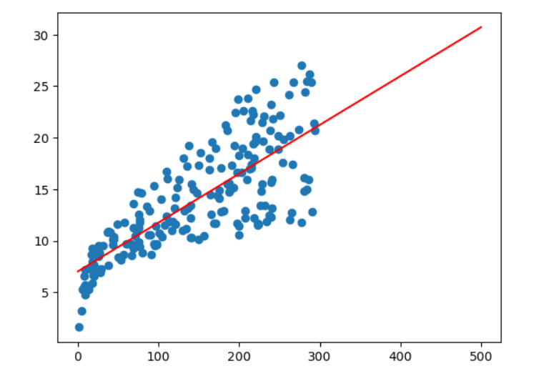
AI Model
We use three different types of method to create AI model and calculate each coefficient .
Use hand
Use Numpy
Use Sklearn
–calculate: B0=7.030561456400215 units
B1=0.04738102938038645 units
-Mean: If we don’t advertising ， we still can do 7 units for B0 and 0.05 units for B1.

Slide 5
Predicted Sales when TV spend is 170
Predict Sales when TV spend is 170 by using Beta0 and Beta1
-to calculate ^yi=15( put 170 into xi)
*But Is this reasonable?
-maybe it’s range
-we need deeply interpretation to get accurate result.
After getting result, use inferential statistics:
Correlation accuracy

Slide 6
RSE
RSE is the sum of SSE/RSS.
Degree of freedom
*Why do we need to use RSE, instead of RRE?
-RSS has problems of python or computer–inaccurate result and problem of units
-The square in RSS can infinitely magnify the results
-Computer limit the memory overflow when it has many datasets
-Computer has the maximum value in RSS.
-However RSE can replace RSS to solve these problems by solving the problems-cannot set lots of variable
If RSE increase,error increase, the result not good.
We use MSE to calculate RSE
-MSE is not degree of freedom–easy to solve

Slide 7
RSE
-RSE means the actual sales in the market deviate from the true regression line by 3265 units on average.
-If coefficient(B0&B1) are accurate, the prediction of sales on the basis of TV advertising would be off 3265 units.
-Whether or not 3455 units in an acceptable prediction error depends on the problem content.
-The average value of sales is around 14,000 units and so the percentage error is 3265/14000=23%.
So, RSE is used to measure the entire model’s fitting error, it’s the result from combined effect of beta 0 and beta 1.
We need each coefficient accuracy measurement without combined result because beta - might not accurate, and when beta 0 change, RSE just gonna change a little bit, so we need to measure each coefficient.

Slide 8
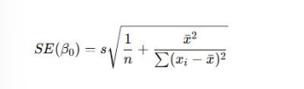

Standard Error
SE is measure two coefficient by using RSE and measure the individual effect of B0 and B1.
The least SE means good, coefficient more reliable.

Slide 9
Confidence Interval
All the basis of the SE is built on the confidence interval.
CI can help us optimize our coefficient with SE by range.
Original B1:0.047381029380386394 / Original BO:7.030561456400218
Why formula times 2?
-two standard deviation
The range is +_ the value of B0 or B1
the range for B0 [-0.8765432176011919 , 0.9713052763619648]
the range for B1 [7.025115398437143 , 7.036007514363287]
If we are not advertising, we will make 7.036 units.
**From a fixed value to a range

Slide 10
Normal Distribution
Gaussian/Normal Distribution is a curve that middle is highest.
*Why is Normal Distribution important?
-natural selection result
-it describes the data distribution in a very straightforward way
- it describes the normality of things and the average
-it describes the density of numbers
1 standard deviation is 68%, in this range-can be used to denoise
According to data that we are given,
Sales are normal distribution
TV and Radio are not normal distribution-uniform distribution
Newspaper is not normal distribution-right distribution

Slide 11
Confidence Interval
CI can be single tail or double tail.
-common value： 90%,95%,99%
-double tail delete slowest and fastest
-single tail delete fastest-cause no reference value
CI mean how many percentage average in these percentage of range
Ex: beta 0 is average value, we are 95% sure that beta 0 is in this range.
95% is double tail result
We have to use normal distribution to make double tail result
–+_ two RSE(Lower bound and Upper bound)
If the value is less or more over than the range—-outliers.
Z-transformation—ratio is the same

